Slide 1
Legal, Ethical, Social and Professionals constraints on information systems
Arish Siddiqui

Slide 2
Learning objectives
At the end of this lecture, you should be able to:
analyse decisions and courses of action from professional, ethical and moral perspectives;
select appropriate and legal courses of action in keeping with professional codes of conduct;
understand and respond to issues of concern, such as personal privacy.

Slide 3
Management issues
From a managerial perspective, this lecture addresses the following areas:
Managers must deal with moral, ethical, professional and legal issues that often conflict with one another.
Responsible organisations must show an awareness of issues that cause concern for employees and the public such as monitoring of employees.
An understanding of legislation is required to ensure that the organisation operates within the law.

Slide 4
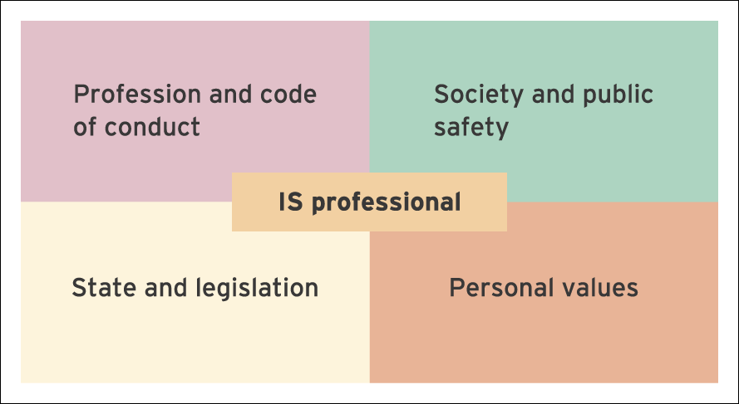
Figure 17.1 Constraints and potential areas of conflict related to the duties and responsibilities of the IS professional

Slide 5
Context
Professionalism: Acting to meet the standards set by a profession in terms of individual conduct, competence and integrity.
Ethics: In general terms, this describes beliefs concerning right and wrong that can be used by individuals to guide their behaviour.
Morality: Individual character or personality and beliefs governing right and wrong.

Slide 6

British Computer Society (BCS)
Code of conduct: Members of professional associations are expected to abide by a set of principles that sets out minimum standards of competence, conduct and behaviour.
British Computer Society (BCS): Widely regarded as the UK’s leading professional association for those involved in the management and development of computer-based information systems.

Slide 7
Information society
Information society: Describes a modern population that is conversant with – and reliant upon – information and communications technology.

Slide 8

The digital divide
Concern is growing that society may eventually become divided into two distinct groups.
One group will be made up of those who have access to technology and are able to obtain information via the Internet.
The other will be made up of those who are unable to gain access to technology and information.

Slide 9

Privacy concerns
Two examples can be used to illustrate common concerns related to privacy:
Example one:
The use of computer-based information systems enables an organisation to combine or analyse data in ways not previously possible with manual systems. As an example, a bank might build up profiles of its customers by analysing their spending, borrowing and saving habits. This information could then be supplied to other organisations involved in marketing relevant goods or services.

Slide 10

Example two
Communications technology allows organisations to share data, allowing them to develop a comprehensive pool of information regarding individuals. An insurance company, for example, might gather medical information before deciding whether or not to offer a policy to an individual.

Slide 11

Computer monitoring
Computer monitoring: The use of computer and communications technology to monitor the activities of individuals.
Echelon:
Echelon is a global surveillance system that monitors communications around the world. The project is operated by the USA, the UK, Canada, Australia and New Zealand. Each day, millions of telephone calls, faxes and e-mail messages are intercepted and scanned for key words and phrases. Messages matching the search criteria used are collected and sent to the United States for further analysis.

Slide 12

Computer criminals
Computer criminals: Make use of technology to perform a variety of criminal acts, ranging from vandalism and sabotage to hacking and fraud.
Information warrior: Seeks to obtain data by any means necessary. Such people may resort to illegal methods, such as hacking, in order to obtain the information they require.
Hacker: Individuals who seek to break into systems as a test of their abilities. Few hackers attempt to cause damage to the systems they access and few are interested in gaining some sort of financial profit.

Slide 13
Hacking motivation
(a) Some hackers hold the belief that all information should be free. Such individuals feel a duty to ensure free access to information held by government departments and private companies.
(b) Many hackers believe that they provide an important service to companies by exposing flaws in security.
(c) Some people believe that hacking serves an educational purpose by helping them to improve their knowledge and skills. Since no harm is caused to any systems accessed, their actions are acceptable and should not be considered threatening.
(d) A final motive for hacking is simply for enjoyment or excitement. Many hackers find stimulation in the challenge of defeating the designers of the security measures used by a given system.

Slide 14
Theft
Theft: In terms of computing, theft normally, but not always, involves altering computer records to disguise the theft of money. The theft of services can include a variety of acts, such as the unauthorised use of a company’s information systems.
Software theft: Software theft, also known as software piracy, involves making unauthorised copies of software applications.
Data theft: Data theft can involve stealing sensitive information or making unauthorised changes to computer records.

Slide 15

Data Protection Act (1984, 1998)
Data Protection Act (1984): Legislation setting out the rights of organisations and individuals in terms of how personal information is gathered, stored, processed and disclosed.
Information shall be obtained and processed ‘fairly and lawfully’.
Information shall be held only for one or more specific and lawful purposes.
Companies should not hold information that is excessive or not relevant to the purposes the company has registered under the Act.

Slide 16
Data Protection Act (1984, 1998) Cont…
Information held on individuals should be accurate and up to date.
Information should not be held for longer than needed.
Individuals have the right to see the data held on them and have corrections made where necessary.
Companies must take measures to protect information from unauthorised access.

Slide 17
Difficulties with the DPA
Conflicts with other legislation: For example, the adoption of the Human Rights Act (1998) has provided UK citizens with a set of fundamental rights, including a right to privacy.
Difficulty in trading across international boundaries: EU regulations place strict controls on the transfer of personal data to organisations based outside of the EU.

Slide 18
Difficulties with the DPA cont…
Lack of clear guidance: Many organisations have found it difficult to incorporate new data protection legislation into existing company policies and procedures. Although the amended Data Protection Act came into force in 2000, there have also been a number of new developments, such as the introduction of the Human Rights Act in 2000. Unfortunately, clarification of some of the issues raised by these changes has been slow to arrive.
Monitoring staff e-mail and Internet use at work: Some people believe that monitoring staff in this way breaches data protection principles since any information gathered is not obtained and processed ‘fairly and lawfully’.

Slide 19

Computer Misuse Act (1990)
An Act to make provision for securing computer material against unauthorised access or modification; and for connected purposes.
Offences:
(a) unauthorised access to computer material;
(b) unauthorised access with the intention of carrying out or assisting others with the commission of further offences;
(c) unauthorised modification of computer material;
(d) impairing the operation of a program or the reliability of data;
(e) preventing or hindering access to any program or data.

Slide 20
The Privacy and Electronic Communications (EC Directive) Regulations 2003
This legislation came into force in December 2003 and brought the UK into compliance with the rest of the European Union regarding issues such as e-mail marketing and telesales.
For industry, this legislation regulates the use of publicly available electronic communications services for direct marketing purposes.
The legislation also covers unsolicited direct marketing activity by telephone, fax, e-mail and automated calling systems and even text messages.
Now requires consent (opt-in) and opt-out.

Slide 21
Copyright, Designs and Patents Act (1988)
Provides organisations and software developers with protection against unauthorised copying of designs, software, printed materials and other works.
Copyright legislation allows a company to safeguard its intellectual property rights (IPR) against competitors and others who might wish to profit from the company’s research and investment.

Slide 22
Copyright, Designs and Patents Act (1988) Cont…..
Patent: Provides its owner with a monopoly allowing them to exploit their invention without competition. The protection offered by a patent lasts for a number of years but does not begin until the patent has been granted.

Slide 23
Regulation of Investigatory Powers Act (2000)
Although many people felt that the Regulation of Investigatory Powers Act (2000) – known as the RIP Act – would have a profound effect on business organisations, its impact has not been as serious as predicted.
The Act introduced measures that allow electronic communications to be monitored by government agencies.

Slide 24
Other laws applying to information
The Obscene Publications Act (1959) and the Protection of Children Act (1978) prohibit the publication of material considered pornographic or excessively violent. This legislation would deal with issues such as copying pornographic materials from the Internet.
The Malicious Communications Act (1988) makes it an offence to send any message that might be considered obscene or threatening.

Slide 25
Other laws applying to information, Cont ….
The Defamation Act (1996) is concerned with slander and libel. This legislation extends to comments made in e-mail messages and material displayed on web sites.
The Electronic Communications Act (2000) is intended to support the growth of e-commerce in the UK. Amongst other things, the Act serves to make electronic signatures legally binding.

Slide 26
Other laws applying to information (continued)
In the wake of the September 11 terrorist attack on the United States, the Anti-terrorism, Crime and Security Act (2001) was introduced in the UK as a means of strengthening existing anti-terrorism legislation.
Of particular importance to the IS industry is a requirement to make sure that certain companies retain data on consumers' Internet and telephone activities and to make sure the data is searchable.
As an example, guidelines from the Home Office suggest that ISPs should keep telephone subscriber and call information for 12 months, e-mail and ISP subscriber data for 6 months, and web activity information for four days.

Slide 27

Summary
analyse decisions and courses of action from professional, ethical and moral perspectives.
select appropriate and legal courses of action in keeping with professional codes of conduct.
understand and respond to issues of concern, such as personal privacy.

Slide 28

Questions ?

